Slide 1
Using Jenkins as a Component
Jonas Bovin, VITEC ALOC
The Jenkins CI User Event 2014

Slide 2
Agenda
Problem domain
Reason for component approach
Implementation
Overview
The mappings
Usage
Run job
Run a parameterized job
Security
Lessons learned

Slide 3
background
We had trouble creating test environments effeciently
The idea of using VM’s had been there a long time
We used Jenkins to create jobs that would execute steps in the process
Like create VM, Load db, install given build on VM
We then wanted to automate the processes and wrote a java package for communicating with the Jenkins API
We used the package in our existing code to create an automated VM booking system

Slide 4
You’re doing what?
Small Java package to control Jenkins
Implemented via the XML-API of Jenkins
Can be used from any Java app
Java native implementation
Same functionality could be achieved from any language

Slide 5
Problem: Creating test environment
Lots of different users
Supporters, Testers, Consultants and developers
Typical scenarios:
Verify a bug in users environment
Test completion of bug-fix
Both require a complete set
VM, Database, specific customer package
Jenkins Builds are paramererized to allow choices
Lots of steps and lots of knowledge required
Time-consuming
wait for one job to finish before starting the next

Slide 6
Steps to Create Test Environment
Parallel
Load db-dump in named database
If one is not already loaded – load some nightly
Create new VM from template
Build customer package from given build#
If one does not already exist
Sequential
Install previously created package
Install CRS
Install Reporting

Slide 7
Introduction to mindset
Claim: Jenkins can do pretty much everything for you, thanks to:
Parameterized builds plugin
Once parameters are introduced you probably make use of entities or properties of entities
The entities will probably not fit inside Jenkins – but also they probably already exist elsewhere in code.
Mission: Evolve your existing domain specific code to leverage on the power of Jenkins – and simply consider it a compontent that will do pretty much everything.

Slide 8
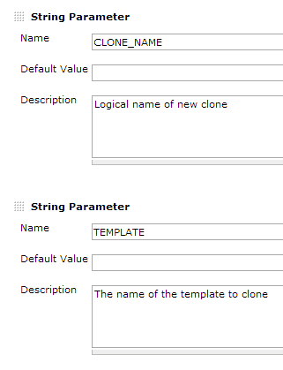
Parameterized Build in 60 seconds
Datatypes: string, boolean, Choice list, other builds, SCM tags etc.
Most support defaults
Choices can be result of groovy scripts!
API: /buildWithParameters?par1=val1
Params not provided uses default value
Param names are case sensitive
Notes:
On lists and choices generated by groovy scripts the first item i default!

Slide 9
Benefits from component approach
Jobs exist and are maintained in Jenkins
But can be called from anywhere in your code
No need to recreate functionality that Jenkins performs well
Jobs are maintained by thier creators/owners in Jenkins
Obvious benefits of Jenkins
Excellent slave handeling
Log
Easy maintenance of jobs
Scales extremely well
Shield non-Jenkins users from Jenkins GUI

Slide 10
Why would you want do that?
Because I can…

Slide 11
Really?
Nope…
We wanted
an automated series of steps to occur on demand
to pass params created during execution of one step to subsequent steps
to report of state/progress of given builds
to keep non-technical staff out of Jenkins
A lot of the entities existed in code elsewhere
Entities that did not really belong in Jenkins
We had created a lot of Jenkins jobs
Which different people were already managing
They worked but were time consuming

Slide 12
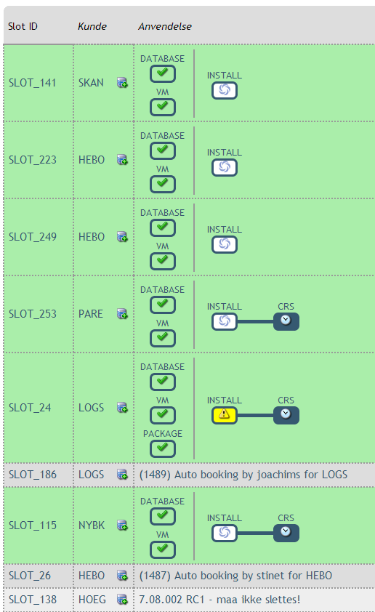
Booking system
Process – created for database slot
Consists of a number of logic steps
Consists of a number of Jenkins jobs
Some are run i parallel

Slide 13
Overview

Slide 14
Why don’t you..?
Use upstream/downstream jobs
Parameters can not be passed to downstream job
We needed to add ‘intelligent choices’ during run
A lot of parameters for later steps are created during first steps
Although stop/start VM is required before install – we don’t want an install always to run after a start
Use existing API packages like Python or Ruby
Our existing code/entities were already written in Java

Slide 15
Atomic Jenkins Jobs
We found that jobs should only perform one task
Think of jobs as atomic functions
Execute several jobs from API to achieve a goal
Like: build, install, test, start VM, stop VM, load DB
Same goes for job-functions as functions in code
Only change/maintain functionality in one place
If a job fails - an issue only related to that function
Typically the owner is informed of the issue via post-build-task – fast problem resolution

Slide 16
The classes and thier mapping
Jenkins entities and classes
Job -> dk.aloc.jenkins.api.JenkinsJob
Build -> dk.aloc.jenkins.api.JenkinsBuild
Queue -> dk.aloc.jenkins.api.JenkinsQueue
QueueItem -> dk.aloc.jenkins.api.JenkinsQueueItem
Helper classes
dk.aloc.jenkins.api.JenkinsBuildProcess
dk.aloc.jenkins.api.JenkinsHelper

Slide 17
Implementation Specifics
Search list of Jenkins masters
Allows us to seamlessly move jobs from one master to another
Upgrades and maintenance can happen on one Jenkins server at the time – without interrupting the booking system

Slide 18
Identifying Jobs
Builds of non-parameterized jobs are time-sequential and can be identified by time of creation (queue) and later build #
Parameterized jobs – however – require special attentions when automating as they are not just ‘next in line’
How we solved identity of parameterized jobs
Implement compare on classes BuildProcess, Build, QueueItem
Compares provided parameters only
Builds executed more than 200 sec’s before request are ignored.
Notes:
Later by build no, but not avaliable when in queue

Slide 19
Comparing builds with params
Provided params Map
Param1=Val1
Param2=Val2
Jenkins params Map
Param2=Val2
Param1=Val1
Param3=DefaultVal
Notes:
Only compare values for keys that exist in both Jenkins job and in provided param map

Slide 20
Run job – simple usage pattern
//Job that requires no parameters
JenkinsJob job = new JenkinsJob(String name);
JenkinsBuildProcess jbp = job.buildNow(String user);
while (!jpb.refreshState()){
Thread.wait(1000);
}
JenkinsBuild jb = jbp.getResult();
If (jb.isSuccess()){
//Great success!
} else {
//Handle usuccessful builds
}

Slide 21
Run job – with params
//Job that requires parameters
JenkinsJob job = new JenkinsJob(String name);
JenkinsBuildProcess jbp = job.buildNow(String user, Map<String,String> params);
while (!jpb.refreshState()){
Thread.wait(1000);
}
JenkinsBuild jb = jbp.getResult();
If (jb.isSuccess()){
//Great success!
} else {
//Handle usuccessful builds
}

Slide 22
Security
Both Jenkins and our web app hook into the AD
The web app retrieves token from Jenkins for logged in user
If a user is not given run permissions, Jenkins will not allow the job to run
In other words: The user has exactly the same rights when using API as he/she would directly on Jenkins

Slide 23
Impersonate user
When running a job from code you will want the responsible user to appear as ‘Started by’
The framework handles this from username provided by app or servlet container
Logs in as Jenkins admin and rips the token from users html page using xpath and logs in as that user/token
Clearly a hack, but it works from 1.554.3 LTS but not 1.472 and earlier
API ‘impersonate’ New Feature on whishlist
JENKINS-18453

Slide 24
Lessens learned
Create a testsuite of all the interfaces used
Run them extensively on Jenkins upgrades
We use WebTest by Canoo
Create thourough unit-tests of API classes
There are many ways a job can end beyond success, failure and unstable!
The Jenkins API is very stable and wicked fast
When communicating with Jenkins API
Don’t use: ?depth=# (possibly large data)
Use tree: ?tree=key[field1,field2,subkey [subfield1]]
Notes:
public enum State {Initiated, Queued, Building, Succeeded, Failed, Unstablalized, Aborted, Finished, Deleted, Unauthorized}

Slide 25
Questions?

Slide 26
References
Parametrized Build Plugin
https://wiki.jenkins-ci.org/display/JENKINS/Parameterized+Build
Python Jenkins API
http://pypi.python.org/pypi/jenkinsapi
Ruby Jenkins API
https://rubygems.org/gems/jenkins_api_client

